Slide 1
Session Management

Slide 2
What is a session?
Session is a conversional state between client and server and it can consists of multiple request and response between client and server.
Note:
Http and Web Server are both stateless
A unique identifier is needed in request and response

Slide 3
Ways to provide session identifier
User Authentication – Username and Password
HTML Hidden Field – Needs form submit
URL Rewriting – Append a session identifier parameter
Cookies – browser needs to enable cookie

Slide 4
Problems With Traditional Session Management
Horizontal scalability for cloud native application
Rebalancing HTTP session limits performance
Large heap size
Multiple accounts per user
Log out and log in is tedious
Multi-level security preview
Can’t switch between roles without logging out
Request over websockets don’t keep the http session alive
Unexpected session out
Accessing session data for non-web requests
REST API or AMQP messages can’t access http session info

Slide 5
Spring Session
Spring Session is easy to:
Write horizontally scalable cloud native applications
Offload the storage of the session into specialized external session stores, such as Redis.
Keep the http session alive when users are making requests over WebSocket
Access session data from non-web request such as JMS message
Support multiple sessions per browser for a richer user experience
Control how session ids are exchanged between clients and server, which makes it easy to write Restful API that can extract session id from an http header rather than relying on cookies

Slide 6
A side note:
Spring Session Project does NOT depend on Spring Framework, so you can use it even when you don’t use Spring Framework

Slide 7
How Spring Session Works
Two key problems at hand:
1. How to create a clustered high availability session that can store data reliably and efficiently
2. How to determine which session instance is associated with which incoming request, whether it is through Http, WebSocket, AMQP or any other protocol

Slide 8
How Spring Session Works
The first problem is well solved by a variety of data stores such as Redis, GemFire, Apache Geode and etc.
Spring Session just need to define a standard set of interfaces
org.springframework.session.Session is an interface that defines the basic capabilities of a session
org.springframework.session.ExpiringSession extends the session interface to determine whether a session is expired
org.springframework.session.SessionRepository defines method to create, save, delete and retrieve a session

Slide 9
How Spring Session Works
For the second problem, how to associate a request to a specific session instance, is protocol specific. This is because the client and server need to agree on a way to transmit the session id during the request/response cycle.
Http session can use cookies or headers
Https can use SSL session id
JMS can use JMS header

Slide 10
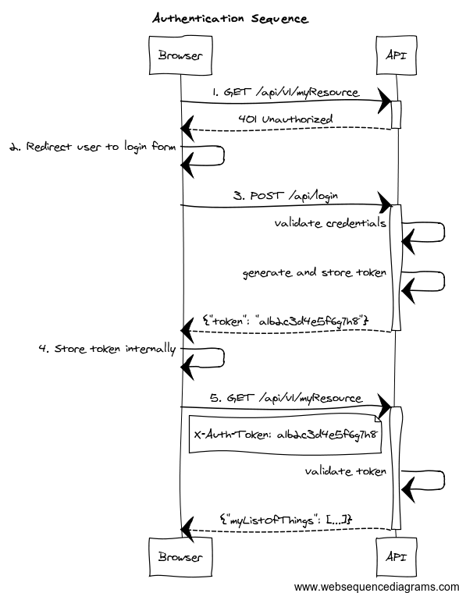
Auth Sequence

